Slide 1

Explain where visible light falls on the electromagnetic spectrum?
Compare and explain how an object‘s material and light‘s frequency affect the way light is reflected, absorbed or transmitted?
Model how the frequency of light affects the color of an object?
Diagram how primary colors of light produce secondary
and complementary colors?
Model how brightness of light is determined?
© Kesler Science, 2016

Slide 2
Explain where visible light falls on the electromagnetic spectrum?
Compare and Explain how an object‘s material and light‘s frequency affect the way light is reflected, absorbed or transmitted?
Model how the frequency of light affects the color of an object?
Diagram how primary colors of light produce secondary and complementary colors?
Model how brightness of light is determined?
© Kesler Science, 2016

Slide 3
I CAN explain where visible light falls on the electromagnetic spectrum?
I CAN compare and explain how an object‘s material and light‘s frequency affect the way light is reflected, obsorbed, or transmitted?
I CAN model how the frequency of light affects the color of an object?
I CAN diagram how primary colors of light produce secondary and complementary colors?
I CAN model how brightness of light is determined?
© Kesler Science, 2016

Slide 4

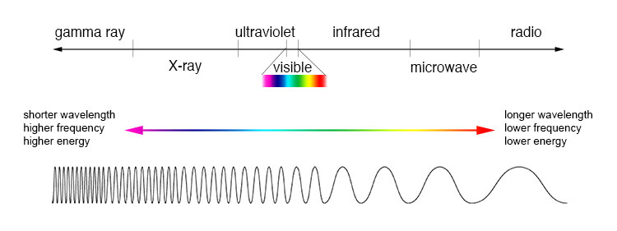
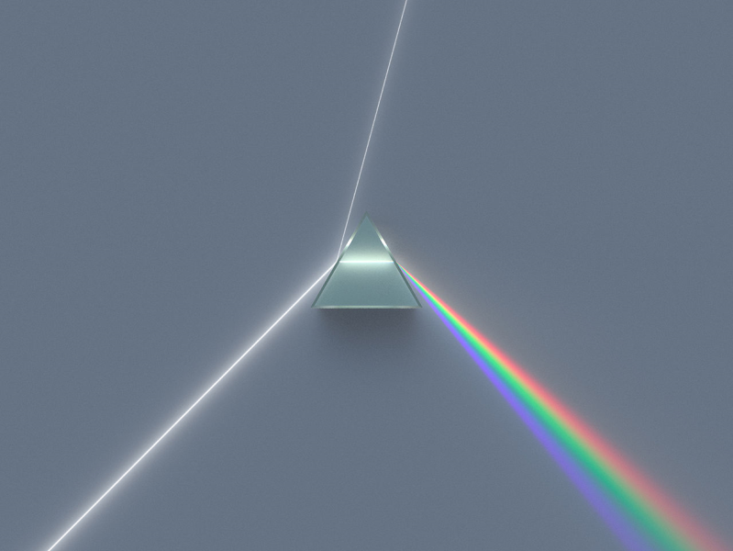
Visible
Light
Spectrum
© KeslerScience.com2016

Slide 5

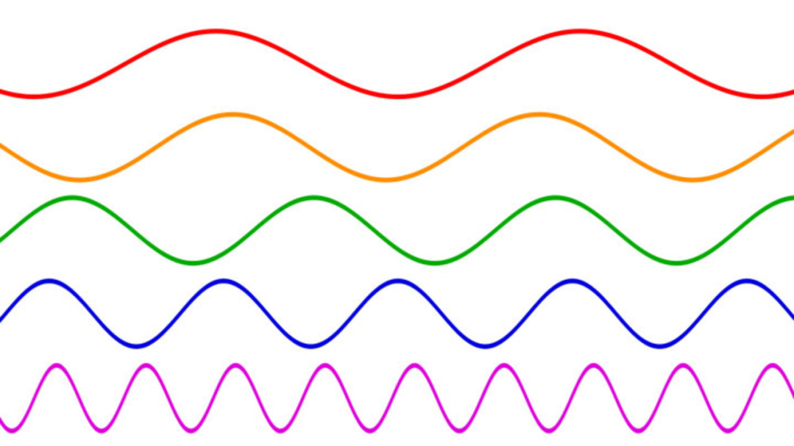
ROY G BIV
Wavelength
of Colors
© KeslerScience.com2016

Slide 6
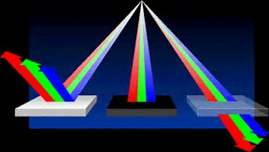
Opaque
Transparent
© KeslerScience.com2016

Slide 7
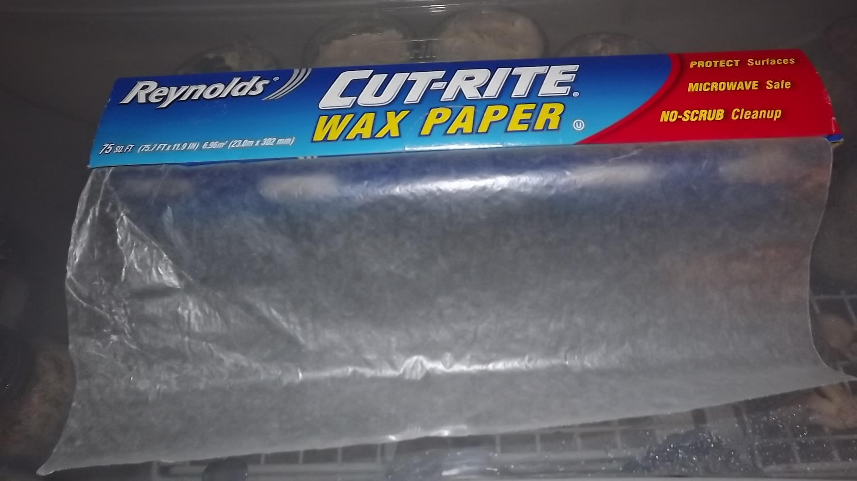
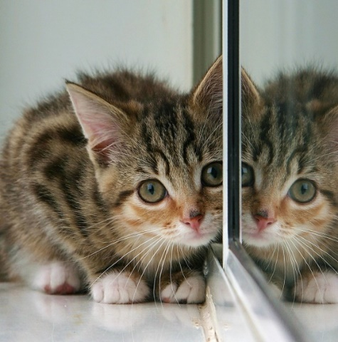
Translucent
Reflect
© KeslerScience.com2016

Slide 8


Diffusion
Refraction
© KeslerScience.com2016

Slide 9
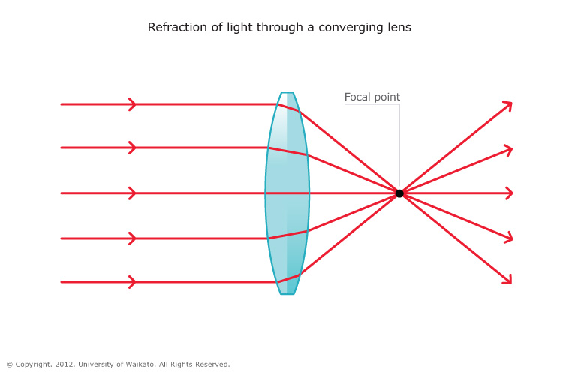
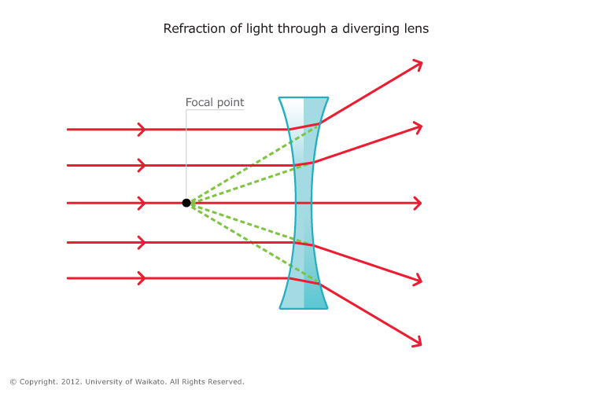
Convex
Lens
Concave
Lens
© KeslerScience.com2016

Slide 10
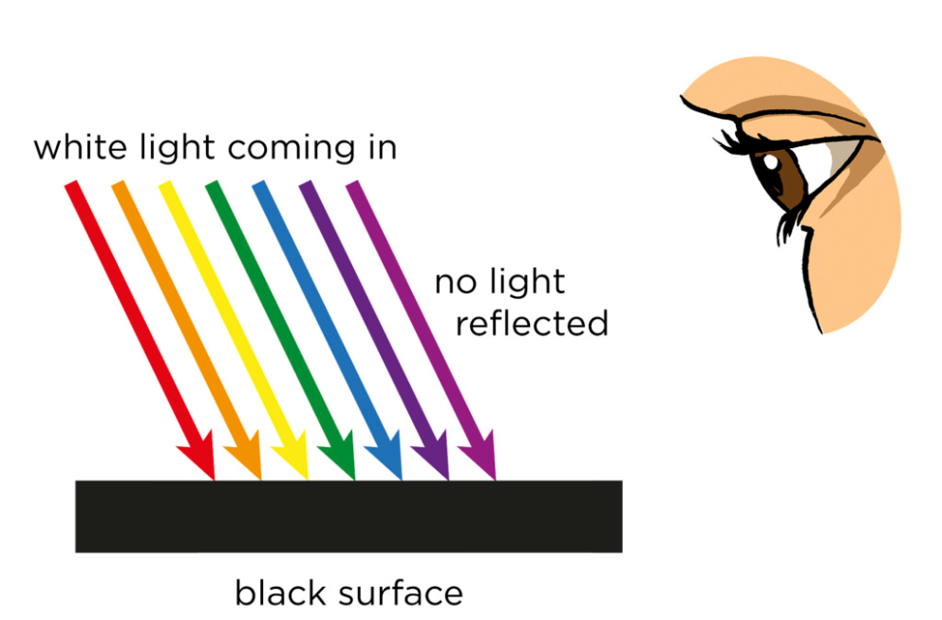
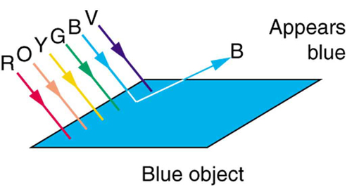
Absorption
Color
© KeslerScience.com2016

Slide 11
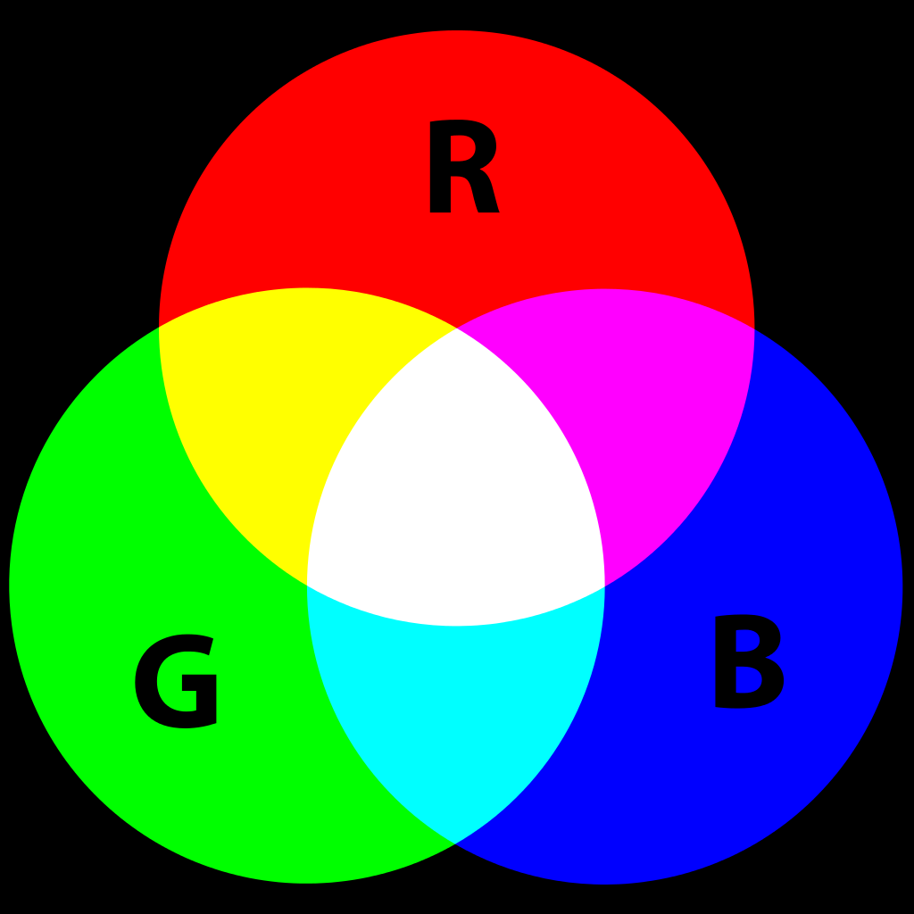
Primary Colors
Secondary
Colors
© KeslerScience.com2016

Slide 12


Complementary
R+G + B R+G+B
Brightness
© KeslerScience.com2016

Slide 13
Visible
Light
Spectrum
© KeslerScience.com2016

Slide 14
ROY G BIV
Wavelength
of Colors
© KeslerScience.com2016

Slide 15
Opaque
Transparent
© KeslerScience.com2016

Slide 16
Translucent
Reflect
© KeslerScience.com2016

Slide 17
Diffusion
Refraction
© KeslerScience.com2016

Slide 18
Convex
Lens
Concave
Lens
© KeslerScience.com2016

Slide 19
Absorption
Color
© KeslerScience.com2016

Slide 20
Primary Colors
Secondary
Colors
© KeslerScience.com2016

Slide 21
Complementary
R+G + B R+G+B
Brightness
© KeslerScience.com2016

